Slide 1
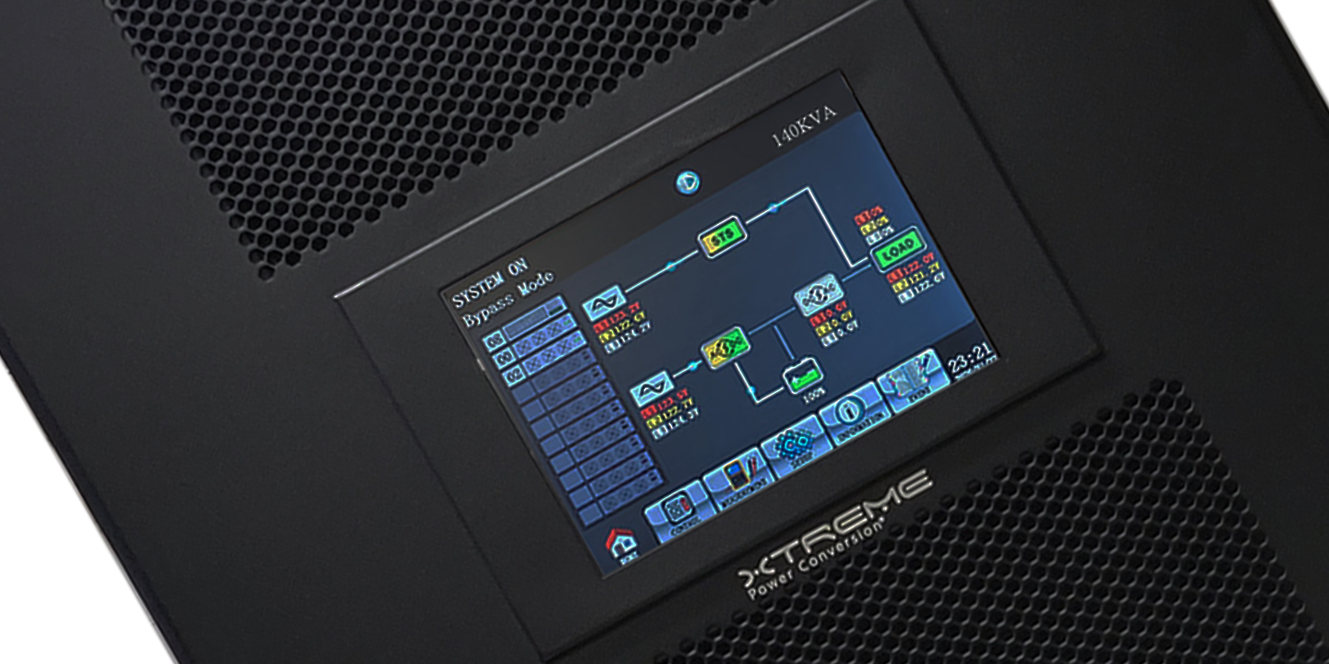
M90U Three-Phase Modular UPS
15kW to 140kW 208/120V
230 Yuma Street
Denver, CO 80223
(800) 582-4524
sales@xpcc.com
www.xpcc.com

Slide 2
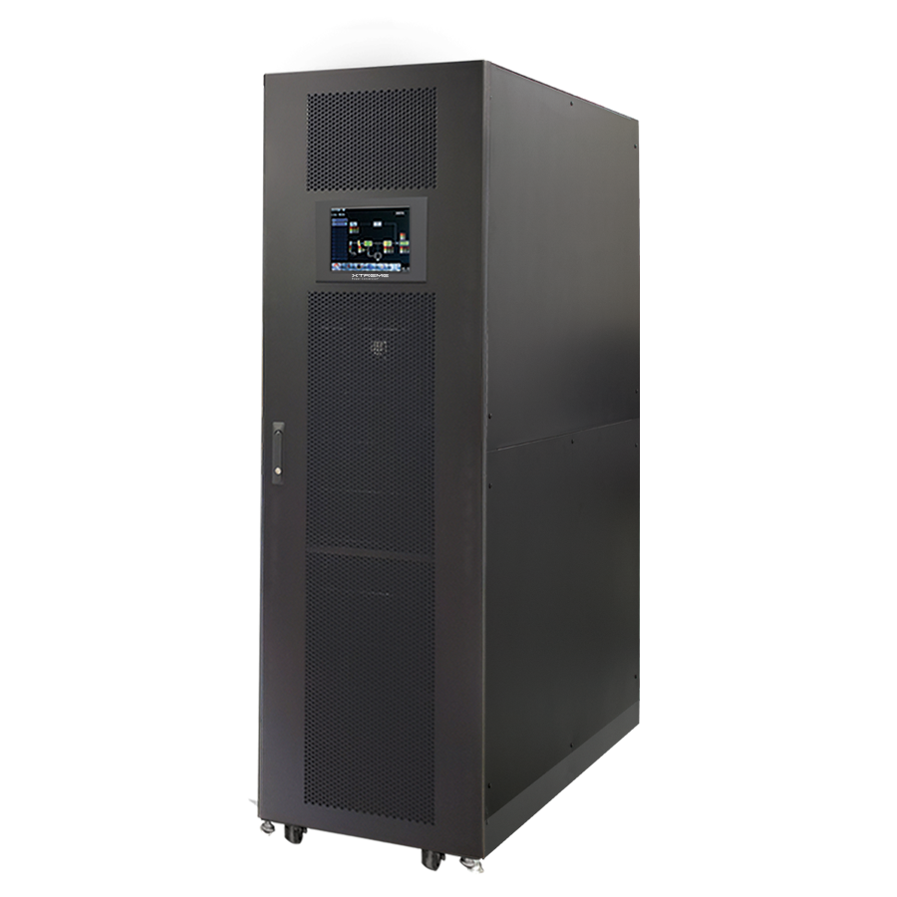
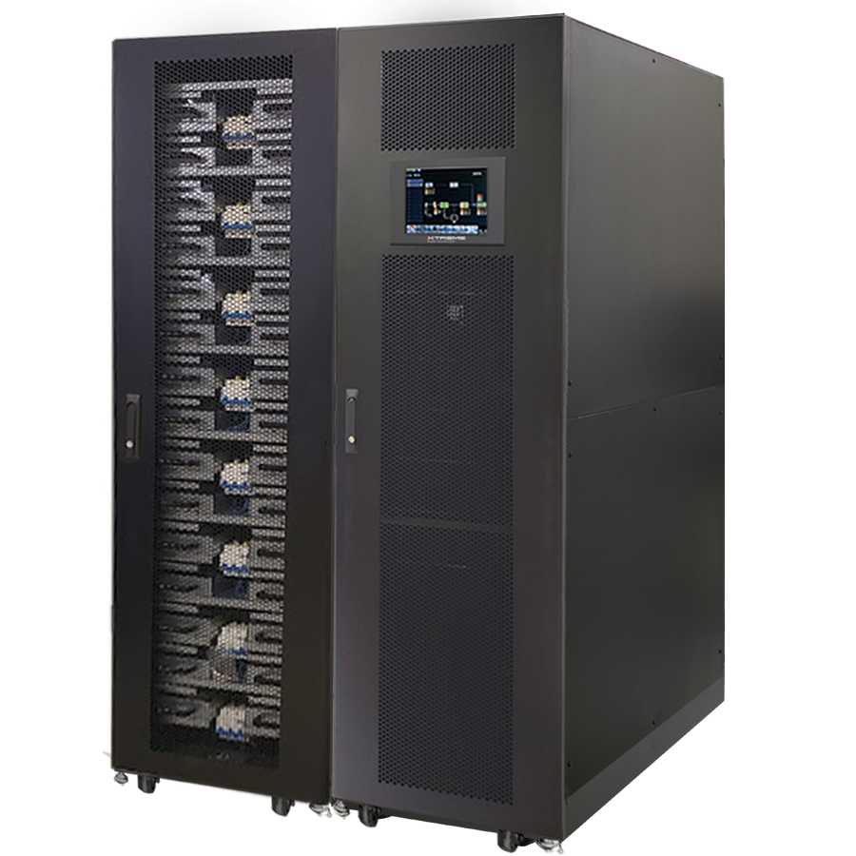
M90U Product Family Overview
Modular UPS // 208/120VAC Three-Phase
Introducing the Xtreme Power M90U UPS 208/120V, 3-Phase
M90U is a scalable, easy-to-deploy 15– 140kW N+1, UPS that delivers top performance to critical infrastructure in commercial and industrial facilities. M90U UPS features industry-leading efficiency in a compact footprint
M90U-80 UPS
M90U-140 UPS+ M90-BC

Slide 3
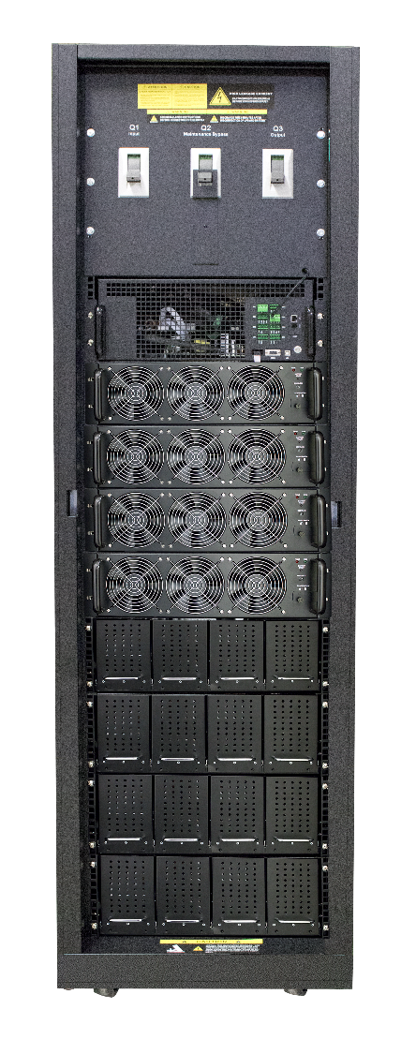
M90U-80 Features
Modular Online UPS // 208/120VAC Three-Phase
Top Feed Cable Entry
Modular Static Switch
20kW or 15kW
Power Modules
Includes PFC rectifier, battery charger, inverter and control circuits
Battery Module
Hot swappable modules
Maintenance Bypass
Full wrap around maintenance bypass with static switch interface
Front and Rear Clearance Required
M90U-80 front

Slide 4
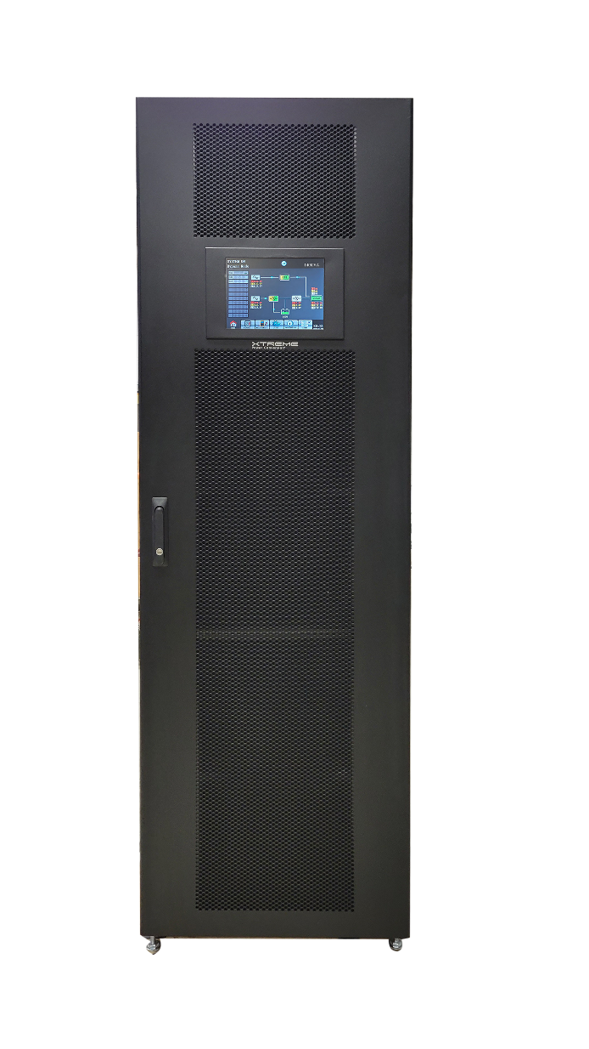
M90U-80 Internal Battery
Modular UPS // 208/120VAC Three-Phase
M90U-80 internal Battery Modules provide a wide range of runtimes

Slide 5
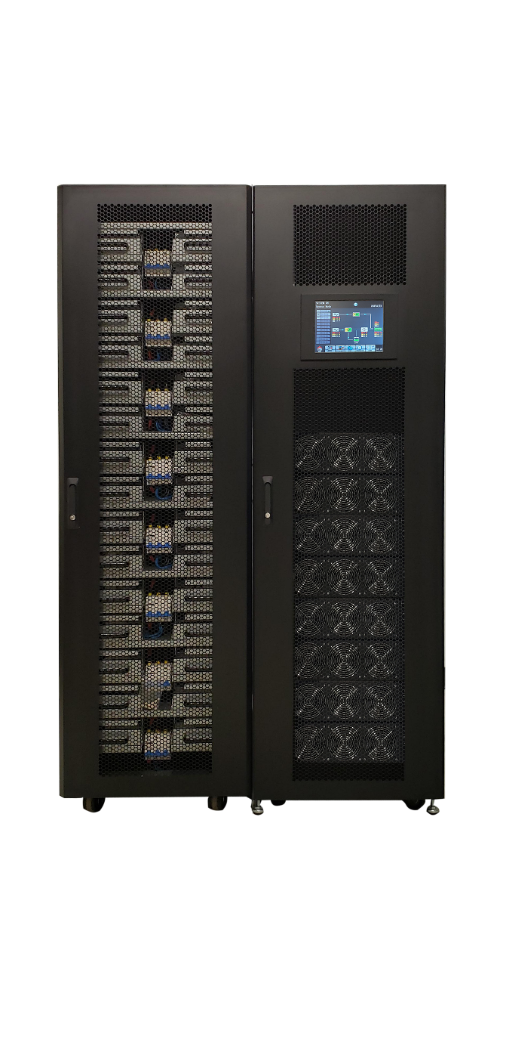
M90U-80 and M90U-140 Footprint
Modular UPS // 208/120VAC Three-Phase
Industry leading footprint saves up to 40% floorspace
Footprint (ft²) including batteries and maintenance bypass
M90U-80
M90U-140 with M90-BC

Slide 6
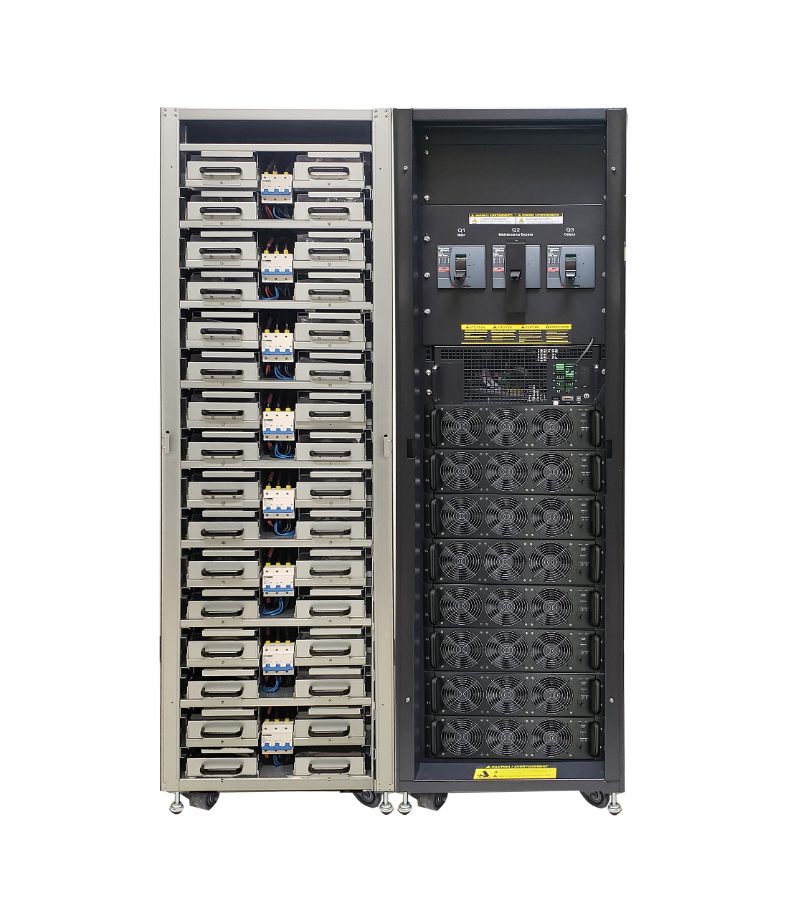
M90U-140 Product Features
Modular Online UPS // 208/120VAC Three-Phase
Up to 8 Battery Strings
Each string consists of 4 battery modules
Top Feed Cable Entry
Maintenance Bypass
Full wrap around maintenance bypass with static switch interface
100A Breaker per Battery String
Isolate individual strings for service or replacement
Modular Static Switch
20kW or 15kW Power Modules
Includes PFC rectifier, battery charger, inverter and control circuits
Hot Swappable Modules
Reduces service time and expense
Up to 8 Power Modules
Configure for 140kW capacity or 140kW N+1 redundancy
M90U-140 + M90-BC front

Slide 7
M90U-140 with M90-BC Battery
Modular UPS // 208/120VAC Three-Phase
M90U-140 with M90-BC provides a wide range of runtimes
M90U-140 Internal Runtime with 8 battery strings

